Slide 1
CS 110 - Professional Practices in IT Instructor Name : Dr Tariq Umer Email : tariqumer@cuilahore.edu.pk

Slide 2
INTELLECTUAL PROPERTY

Slide 3
What We Will Cover
What is Intellectual Property
Intellectual Property and Changing Technology
Copyright Law
Pakistan copy rights law

Slide 4
Intellectual Property
Intellectual property is a term used to describe works of the mind—such as art, books, films, formulas, inventions, music, and processes—that are distinct, and owned or created by a single person or group.
Intellectual property is protected through copyright, patent, and trade secret laws.

Slide 5
What Is Intellectual Property?
Term used to describe works of the mind
Distinct and “owned” or created by a person or group
Copyright law
Protects authored works
Patent law
Protects inventions
Trade secret law
Helps safeguard information critical to an organization’s success

Slide 6
What Is Intellectual Property?
Such laws can also present potential ethical problems for IT companies and users
Some innovators believe that copyrights, patents, and trade secrets stifle creativity by making it harder to build on the ideas of others.
Meanwhile, the owners of intellectual property want to control and receive compensation for the use of their intellectual property.

Slide 7
What Is Intellectual Property?
Defining and controlling the appropriate level of access to intellectual property are complex tasks.
Protecting computer software has proven to be difficult because it has not been well categorized under the law.
Software has sometimes been treated as the expression of an idea, which can be protected under copyright law, but it has also been treated as a process for changing a computer’s internal structure, making it eligible for protection under patent law.
At one time, software was even judged to be a series of mental steps, making it inappropriate for ownership and ineligible for any form of protection.

Slide 8
Copyrights
Established in the U.S. Constitution
Article I, Section 8, Clause 8
“to promote the Progress of Science and useful Arts, by securing for limited Times to Authors and Inventors the exclusive Rights to their respective Writings and Discoveries.”; computer programs were assigned to the literary works category
Grants creators of original works the exclusive right to:
Distribute
Display
Perform
Reproduce work
Prepare derivative works based upon the work
Author may grant exclusive right to others

Slide 9
Copyrights
Copyright term
Copyright law guarantees developers the rights to their works for a certain amount of time
Copyright infringement is a violation of the rights secured by the owner of a copyright.
Infringement occurs when someone copies a substantial and material part of another’s copyrighted work without permission.
The courts have a wide range of discretion in awarding damages—from $200 for innocent infringement to $100,000 for willful infringement.

Slide 10
Copyrights
Types of work that can be copyrighted
Architecture
Art
Audiovisual works
Choreography
Drama
Graphics
Literature
Motion pictures
Music
Pantomimes
Pictures
Sculptures
Sound recordings

Slide 11
Copyrights
software, video games, multimedia works, and Web pages can all be protected.
However, evaluating the originality of a work is not always a straightforward process, and disagreements over whether or not a work is original sometimes lead to litigation.
Copyright law tries to strike a balance between protecting an author’s rights and enabling public access to copyrighted works.

Slide 12
Copyrights
Must fall within one of the preceding categories
Must be original
Evaluating originality can cause problems
Fair use doctrine (Principles)
Allows portions of copyrighted materials to be used without permission under certain circumstances
Maintains balance between protecting an author’s rights and enabling public access to copyrighted works
Factors to consider when evaluating the use of copyrighted material

Slide 13
Copyrights
Fair use doctrine factors include:
Purpose and character of the use
Nature of the copyrighted work
Portion of the copyrighted work used
Effect of the use upon the value of the copyrighted work
Key concept: an idea cannot be copyrighted, but the expression of an idea can be

Slide 14
Copyrights
Copyright infringement (violations)
Copy substantial and material part of another’s copyrighted work
Without permission
Software copyright protection
Raises many complicated issues of interpretation
Copyright law should not be used to inhibit interoperability between the products of rival vendors

Slide 15
Copyrights
The Prioritizing Resources and Organization for Intellectual Property (PRO-IP) Act of 2008
Increased enforcement and substantially increased penalties for infringement
General Agreement on Tariffs and Trade (GATT)
Trade agreement between 117 countries
Created World Trade Organization (WTO) to enforce
Despite GATT, copyright protection varies greatly from country to country

Slide 16
Copyrights
The World Trade Organization (WTO) deals with rules of international trade based on WTO agreements that are negotiated and signed by members of the world’s trading nations
Many nations recognize that intellectual property has become increasingly important in world trade
Established minimum levels of protection that each government must provide to the intellectual property of members
Covers copyright, patents, and trade secrets

Slide 17
Copyrights
World Intellectual Property Organization (WIPO)
Agency of the United Nations
WIPO is dedicated to developing “a balanced and accessible international intellectual property (IP) system, which rewards creativity, stimulates innovation and contributes to economic development while safeguarding the public interest.”
Advocates for the interests of intellectual property owners
WIPO Copyright Treaty provides additional copyright protections for electronic media

Slide 18
Software Copyrights in Pakistan
In Pakistan the computer program has been protected under the copyright domain. For this purpose, the definition of “literary work” is amended by the Copyright (Amendment) Act, 1992 to include computer programs under the copyright regime.
Copyright (Amendment) Act, 1992, section 2p:
The Ordinance defines literary work to include work, on computer programmes “that is to say programs recorded on any disc, tape, perforated media or other information storage devices, which, if fed into or located in a computer or computer based equipment is capable of reproducing any information”.

Slide 19
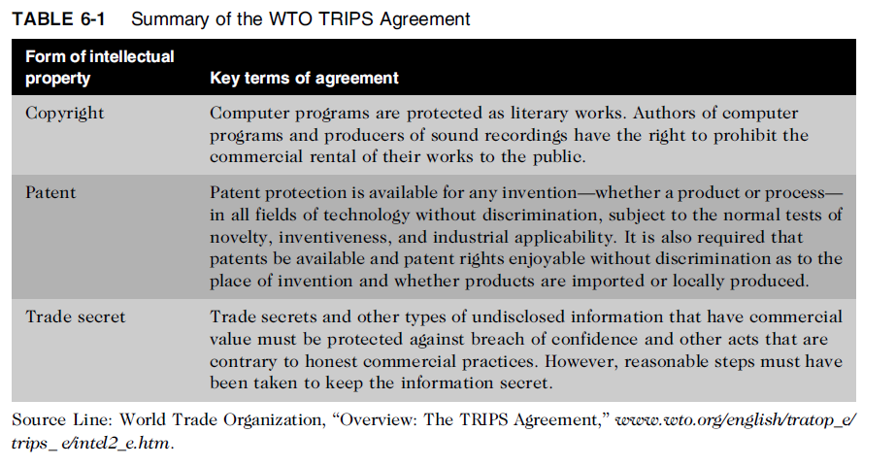

Slide 20
Pakistan copy rights law

Slide 21
Intellectual Copy right law in Pakistan
Copyright law in Pakistan was first introduced in 1962 through an Ordinance.
It was a comprehensive document and covered all aspects including civil remedies, offences, penalties and appeals.
In pursuance of Section 45 of the Ordinance, a Copyright Board was constituted by the Federal Government which was deemed to be a civil court under the Criminal Procedure Act of 1898 and proceedings before the Board were deemed to be the judicial proceedings within the meaning of the relevant sections of Pakistan Penal Code.

Slide 22
Intellectual Copy right law in Pakistan
In 1972, massive devaluation of Pakistani currency altogether changed the situation of book industry.
Books of foreign origin were the main source in almost all higher educational institutions including professional and technical institutions.
As a result, the price of these books increased beyond the reach of ordinary students. The shortage of books so occurred resulted in disturbances on the campuses that created a law and order situation in the country.

Slide 23
Intellectual Copy right law in Pakistan
The Government therefore added sub-section 2A to Section 10 as reproduced below:
“2A) Copyright shall not subsist in any work referred to in sub-section: (2) as respects its reprint, translation, adaptation or publication, by or under the authority of the Federal Government as textbook for the purposes of teaching, study or research in educational institutions.”

Slide 24
National book foundation
National Book Foundation (NBF) was established in 1972 through an Act of the Parliament.
The objectives envisioned in its charter were primarily educational welfare and service rendering focusing on book promotion and book development activities.
The Government of Pakistan authorized NBF to reprint books needed by the students at low prices. This infuriated the foreign publishers who took it as infringement of copyright.

Slide 25
Reproduction of foreign Textbooks
Reproduction of foreign textbooks was one of the activities of the NBF besides other important and major operations including free Braille books for the visually handicapped people.
As a policy, the NBF, in consultation with the USA and the UK Publishers Associations, decided to pay royalty of all the books published by it and also forwarded agreements with a view to seeking their consent. Royalties were accepted by the publishers while the agreements duly signed were received in almost 90% cases.
This practice continued smoothly till 90s when the reprint program of NBF was restricted and the local pirated editions started flooding the market.

Slide 26
Intellectual property right law
Accordingly, amended copyright laws were introduced by Pakistan in the year 2000.
In the said amended law, the controversial sub-section 2A of Section 10 was deleted. However, a new sub-section in Section 36 after sub-section 2 was introduced whereby the Federal Government or the Board could grant a license to reprint, translate, adapt or publish any textbook on non-profit basis.
In pursuance of the Government policies to respect international obligations, the NBF further restricted its reprint Programme inspire of legal remedy available and now it has virtually stopped it. Simultaneously, it initiated efforts in collaboration with IPO to persuade the foreign publishers for print licenses

Slide 27
Conclusion
What is intellectual property?
How to protect?
Pakistan Intellectual Property Rights

Slide 28
THE END

